Slide 1
Smart water fountains
Phase 3:Develpoment part 1

Slide 2
AGENDA
Introduction
Hardware setup
Iot Device configuration
Data collection script Development
Real-Time Data updates and testing

Slide 3
INTRO-DUCTION
Water fountains have long been a staple in public spaces, providing access to clean and refreshing drinking water. However, as society becomes more connected, eco-conscious, and data-driven, the traditional water fountain is evolving into a "smart" water fountain. These intelligent water dispensers leverage IoT technology to offer a range of benefits for both users and municipalities.

Slide 4
Hardware setup
ESP32 microcontroller:
The ESP32 is a versatile microcontroller with built-in Wi Fi and Bluetooth capabilities, making it suitable for IoT applications. It will serve as the core component of your monitoring device.
Connect the water quality sensor, flow rate sensor, and temperature sensor to the ESP32 using appropriate interfaces (e.g., analog or digital pins).

Slide 5
IoT Device Configuration

Slide 6
BILl 0f materials
ESP32 Development Board (e.g., ESP32 NodeMCU or ESP32 DevKitC)
Water Quality Sensor (e.g., pH sensor, turbidity sensor, or chlorine sensor)
Flow Rate Sensor (e.g., Hall effect sensor)
Temperature Sensor (e.g., DS18B20)
Relay Module or Solenoid ValvesProximity Sensor (Optional)
Power Supply (e.g., 5V power adapter or battery pack)
TFT Touchscreen Display (Optional)
Enclosure for ElectronicsCables and WiringResistors, Capacitors, and Diodes (as needed for sensor interfacing)

Slide 7
Development of environment setup
Install the necessary development tools and libraries on your computer to program the ESP32. You can use the Arduino IDE or the PlatformIOdevelopment platform for ESP32 development.

Slide 8
programming
Write a program in the chosen development environment that reads data from the DHT22 sensor.
Use the appropriate libraries for the ESP32 to interact with the sensor. For the DHT22, you would typically use the Adafruit DHT library or similar libraries

Slide 9
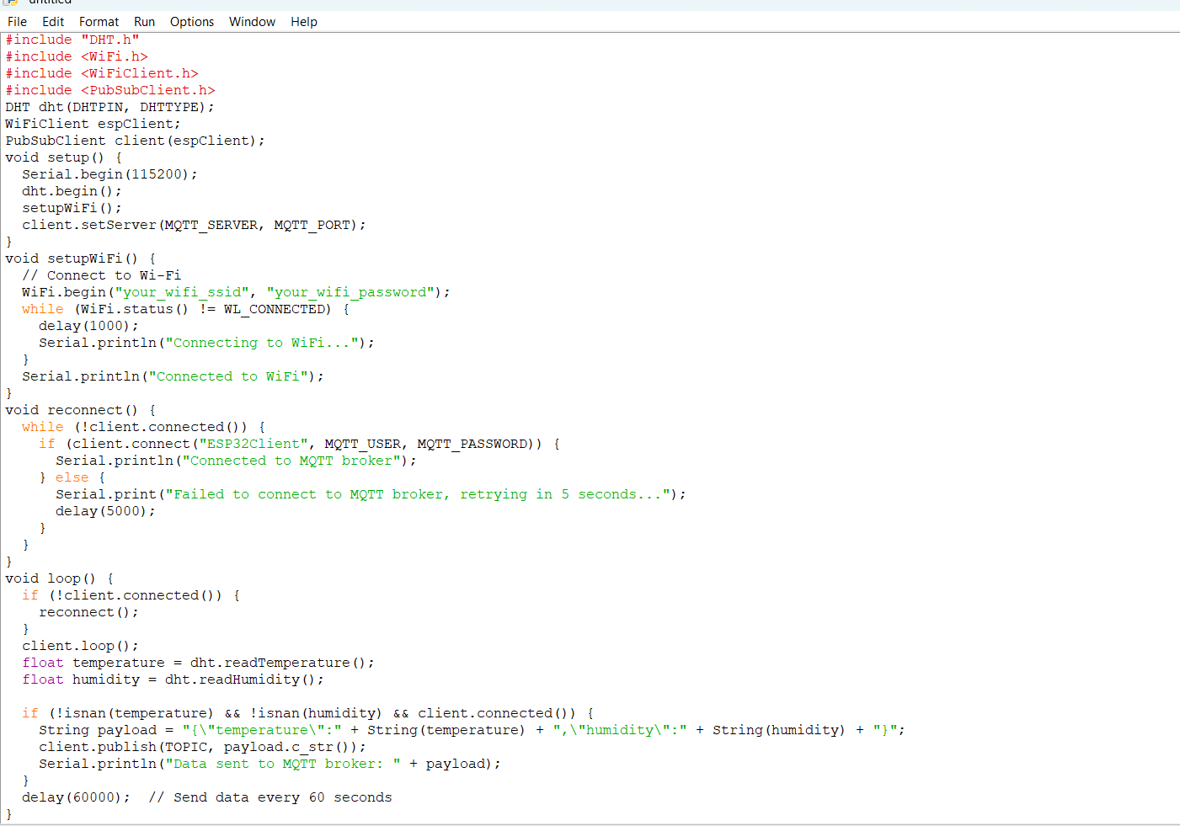

Slide 10
Real-Time Data Updates and Testing In this phase, the IoT device with its sensors and data collection script is tested rigorously to ensure accurate and reliable data collection. Data updates occur at predefined intervals to simulate real-time conditions, and the system is monitored for consistent performance. This phase is critical to verify the functionality and reliability of the hardware and software components in preparation for deployment and integration with the data-sharing platform

Slide 11
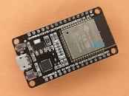
EPS32 MICROCONTROLLER:

Slide 12
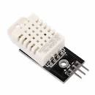
DTH22 sensor:

Slide 13
DTH22 sensor: sensors are very basic and slow, but are great for hobbyists who want to do some basic data logging. The DHT sensors are made of two parts, a capacitive humidity sensor and a thermistor. There is also a very basic chip inside that does some analog to digital conversion and spits out a digital signal with the temperature and humidity. The digital signal is fairly easy to read using any microcontroller

Slide 14
SUMMARY
In conclusion, smart water fountains integrated with IoT represent a significant step forward in urban and public infrastructure. They not only provide convenient and safe drinking water but also contribute to sustainability and data-driven management. As technology continues to evolve, we can anticipate even more innovative features and applications for these IoT-enabled fountains in the future.

Slide 15
THANK YOU

